Slide 1
Internal Sorting
A brief review and some new ideas
CS 400/600 – Data Structures

Slide 2
Definitions
Model: In-place sort of an array
Stable vs. unstable algorithms
Time measures:
  Number of comparisons
  Number of swaps
Three “classical” sorting algorithms
  Insertion sort
  Bubble sort
  Selection sort

Slide 3
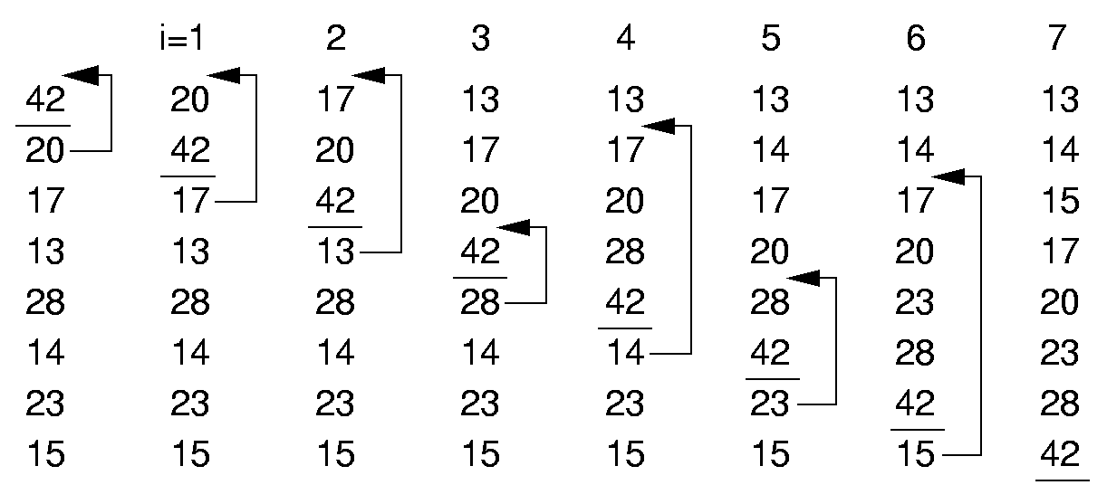
Insertion Sort
template <class Elem, class Comp>
void inssort(Elem A[], int n) {
for (int i=1; i<n; i++)
for (int j=i; (j>0) &&
(Comp::lt(A[j], A[j-1])); j--)
swap(A, j, j-1);
}
i=1 2 3 4 5 6 7

Slide 4
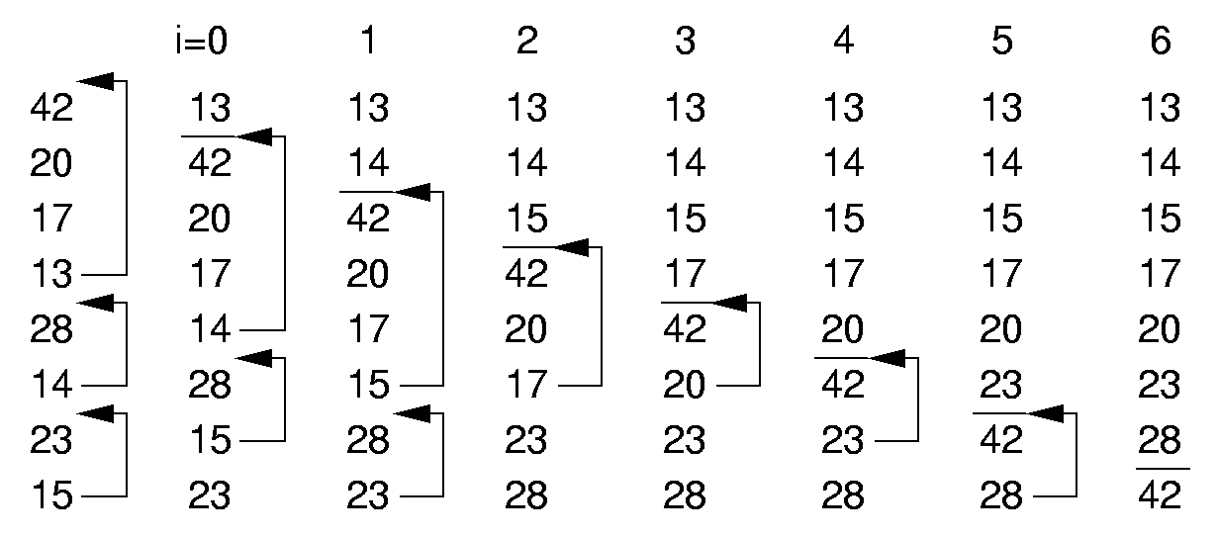
Bubble Sort
template <class Elem, class Comp>
void bubsort(Elem A[], int n) {
for (int i=0; i<n-1; i++)
for (int j=n-1; j>i; j--)
if (Comp::lt(A[j], A[j-1]))
swap(A, j, j-1);
}
i=1 2 3 4 5 6 7

Slide 5
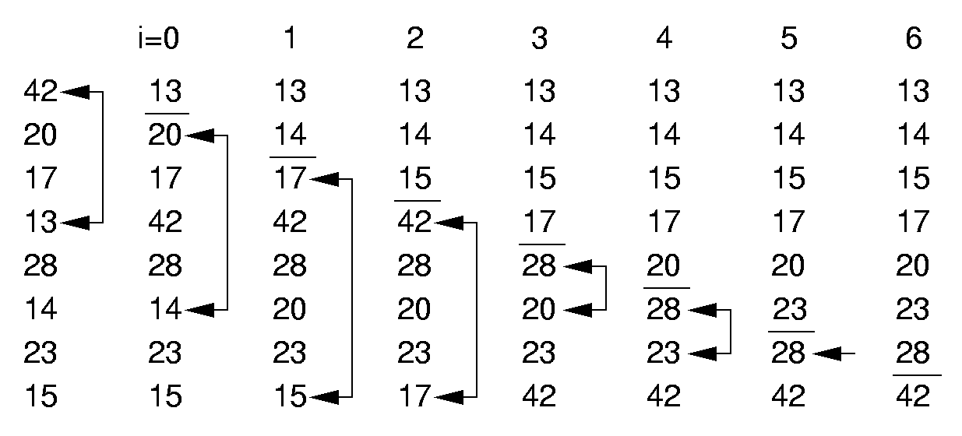
Selection Sort
template <class Elem, class Comp>
void selsort(Elem A[], int n) {
for (int i=0; i<n-1; i++) {
int lowindex = i; // Remember its index
for (int j=n-1; j>i; j--) // Find least
if (Comp::lt(A[j], A[lowindex]))
lowindex = j; // Put it in place
swap(A, i, lowindex);
}
}
i=1 2 3 4 5 6 7

Slide 6
Summary
Insertion Bubble Selection
Comparisons:
Best Case Θ(n) Θ(n²) Θ(n²)
Average Case Θ(n²) Θ(n²) Θ(n²)
Worst Case Θ(n²) Θ(n²) Θ(n²)
Swaps:
Best Case 0 0 Θ(n)
Average Case Θ(n²) Θ(n²) Θ(n)
Worst Case Θ(n²) Θ(n²) Θ(n)
All of these algorithms are known as exchange sorts.

Slide 7
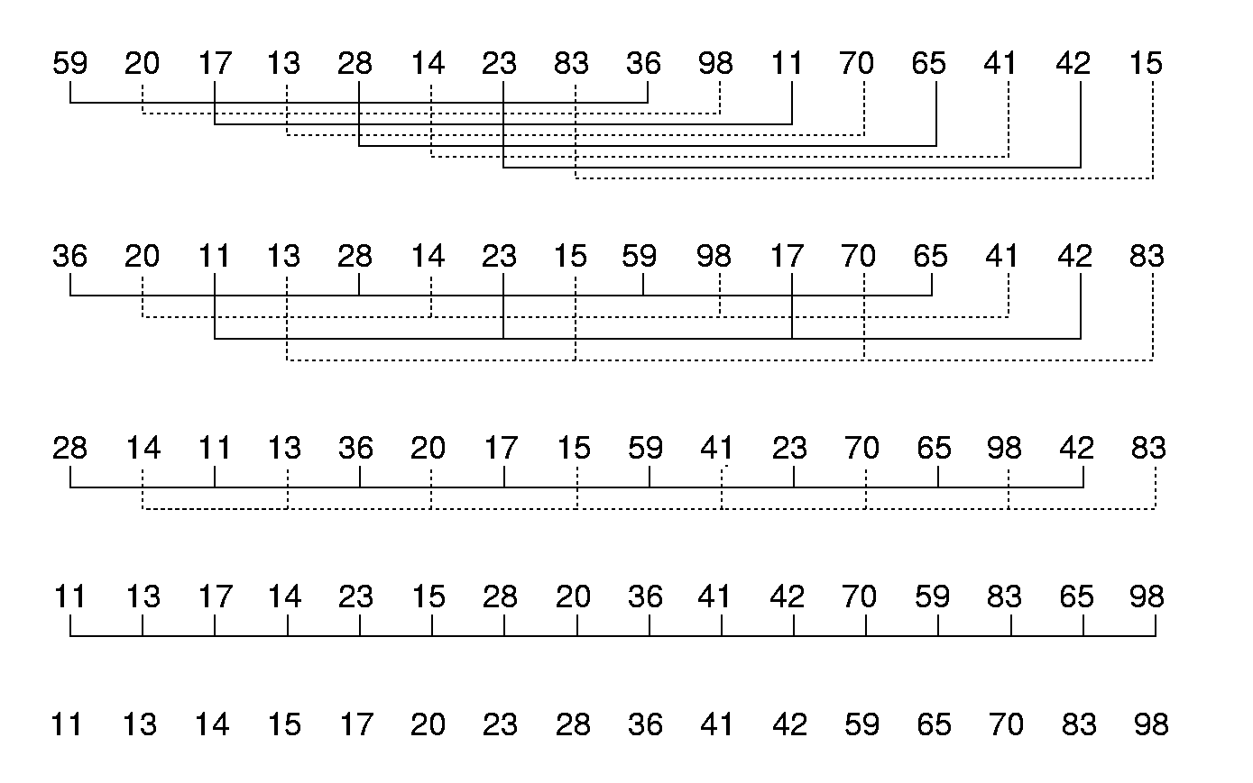
Shellsort

Slide 8
Shellsort Implementation
// Modified version of Insertion Sort
template <class Elem, class Comp>
void inssort2(Elem A[], int n, int incr) {
for (int i=incr; i<n; i+=incr)
for (int j=i;
(j>=incr) &&
(Comp::lt(A[j], A[j-incr])); j-=incr)
swap(A, j, j-incr);
}
template <class Elem, class Comp>
void shellsort(Elem A[], int n) {
for (int i=n/2; i>2; i/=2) // For each incr
for (int j=0; j<i; j++) // Sort sublists
inssort2<Elem,Comp>(&A[j], n-j, i);
inssort2<Elem,Comp>(A, n, 1);
}

Slide 9
Quicksort
A BST provides one way to sort:
27, 12, 35, 50, 8, 17
27
This node splits the data into values < 27 and values ≥ 27.
In quicksort this is called a pivot value.
12
35
8
17
50

Slide 10
Quicksort overview
Find a pivot value
Arrange the array such that all values less than the pivot are left of it, and all values greater than or equal to the pivot are right of it
Call quicksort on the two sub-arrays
20
65
12
52
17
96
8
8
20
17
12
52
65
96

Slide 11
Quicksort
template <class Elem, class Comp>
void qsort(Elem A[], int i, int j) {
if (j <= i) return; // List too small
int pivotindex = findpivot(A, i, j);
swap(A, pivotindex, j); // Put pivot at end
// k will be first position on right side
int k =
partition<Elem,Comp>(A, i-1, j, A[j]);
swap(A, k, j); // Put pivot in place
qsort<Elem,Comp>(A, i, k-1);
qsort<Elem,Comp>(A, k+1, j);
}
template <class Elem>
int findpivot(Elem A[], int i, int j)
{ return (i+j)/2; }
Notes:
Initial call: qsort(A, 0, n-1);

Slide 12
Quicksort Partition
template <class Elem, class Comp>
int partition(Elem A[], int l, int r,
Elem& pivot) {
do { // Move the bounds inward
// until they meet
// Move l right, and r left
while (Comp::lt(A[++l], pivot));
while ((r != 0) && Comp::gt(A[--r], pivot));
swap(A, l, r); // Swap out-of-place values
} while (l < r); // Stop when they cross
swap(A, l, r); // Reverse last swap
return l; // Return first pos on right
}
The cost for partition is Θ(n).

Slide 13
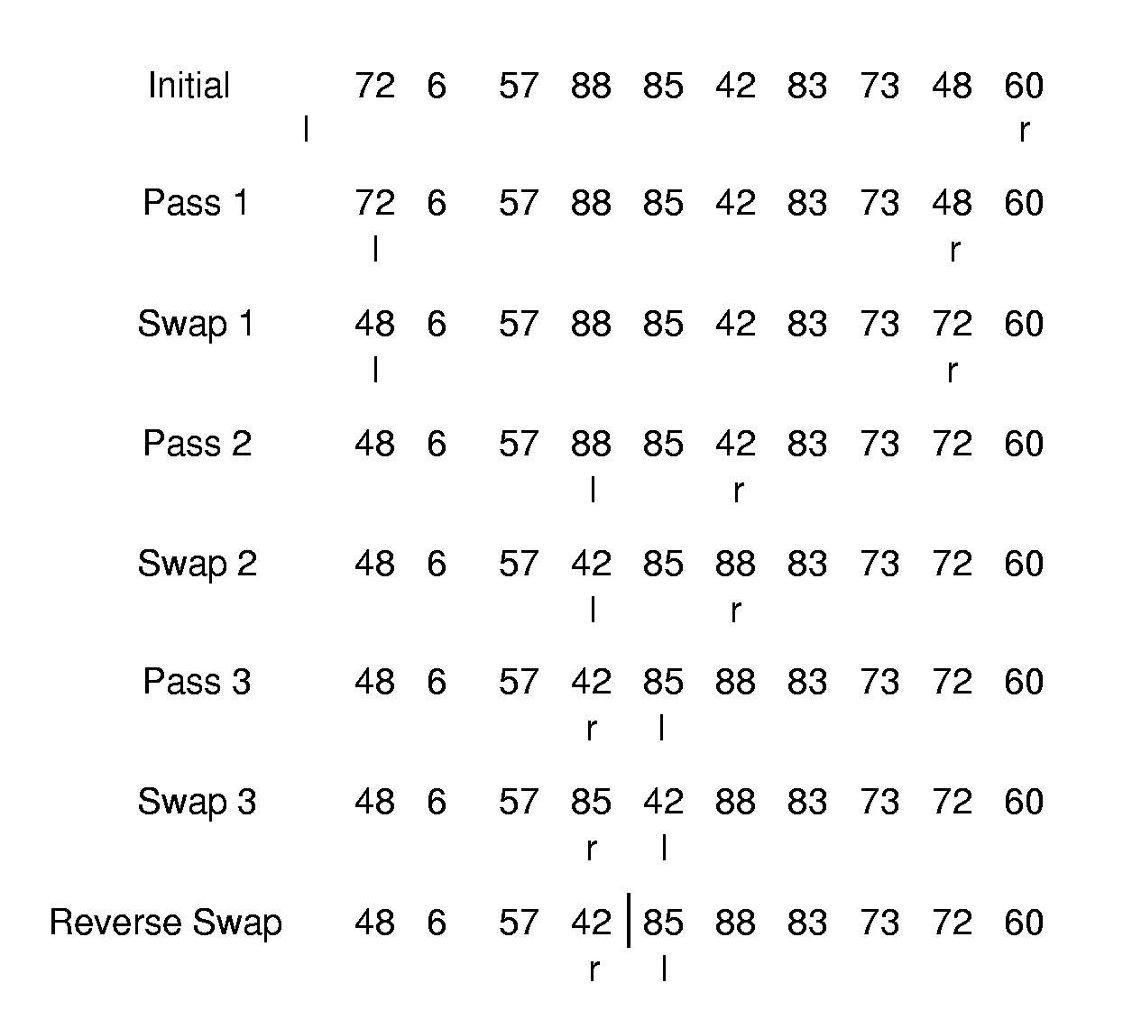
Partition Example

Slide 14
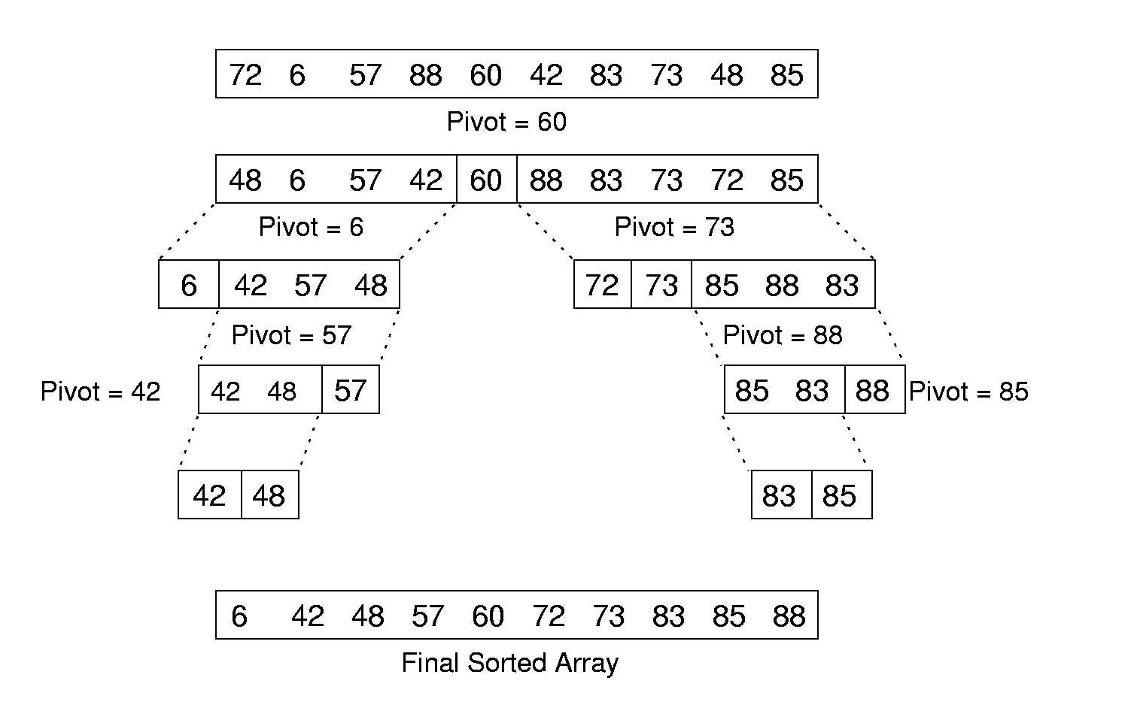
Quicksort Example

Slide 15
Cost of Quicksort
Best case: Always partition in half = Θ(n log n)
Worst case: Bad partition = Θ(n²)
Average case:
T(n) = n + 1 + 1/(n-1) Σ(T(k) + T(n-k))
Optimizations for Quicksort:
  Better Pivot
  Better algorithm for small sublists
  Eliminate recursion
n-1
k=1
Notes:
Best and average cases are Θ(n log n). Worst case is Θ(n²).

Slide 16
Mergesort
Conceptually simple
Good run time complexity
But…difficult to implement in practice

Slide 17
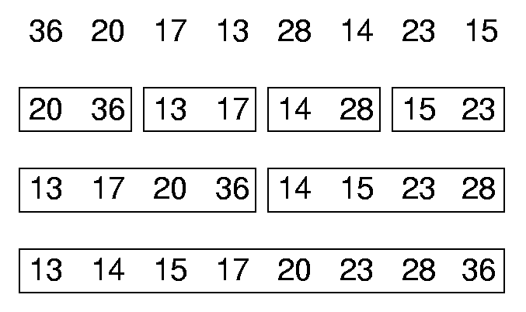
Mergesort details
List mergesort(List inlist) {
if (inlist.length() <= 1)return inlist;
List l1 = half of the items from inlist;
List l2 = other half of items from inlist;
return merge(mergesort(l1),
mergesort(l2));
}

Slide 18
Mergesort considerations
Good for linked lists
  How to split up
When used for arrays, requires more space
Naturally recursive
Time complexity:
  Recursive split = (log n) steps
  Merge for each of the smaller arrays, a total of n steps each
  Total = n log n

Slide 19
Binsort
Suppose we have an array, A, of integers ranging from 0 to 1000:
for (i=0; i<n; i++)
Sorted[A[i]] = A[i];
n steps to place the items into the bins
MAXKEY steps to print out or access the sorted items
  Very efficient if n ≈ MAXKEY
  Inefficient if MAXKEY is much larger than n

Slide 20
RadixSort
Can be fast, but difficult to implement…

Slide 21
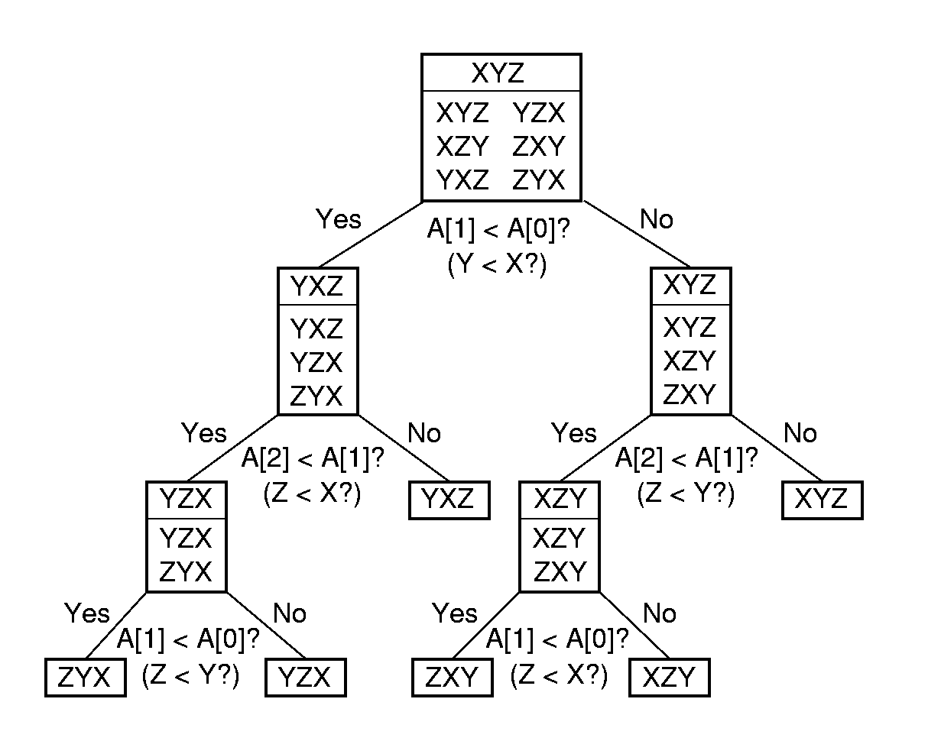
Sorting as a decision tree

Slide 22
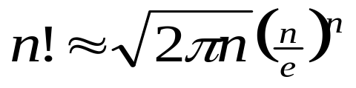
Lower Bounds of Sorting Algorithms
There are n! permutations.
A sorting algorithm can be viewed as determining which permutation has been input.
Each leaf node of the decision tree corresponds to one permutation.
A tree with n nodes has Ω(log n) levels, so the tree with n! leaves has Ω(log n!) = Ω(n log n) levels.

